Slide 1
DATABASE PROJECT: SPOTIFY ANALYSIS
12/07/2018
DATA ENGINEERING PLATFORMS
MScA 31012
FRIDAY6_9GROUP1
Team members:
Jorge Argueta | Anh Phan
Weihuang Xie | Jihun Lee

Slide 2
AGENDA
Executive Summary
Business Use Cases
Data Processing
Data Modeling
Business Analysis
Future Work
Lesson Learned

Slide 3
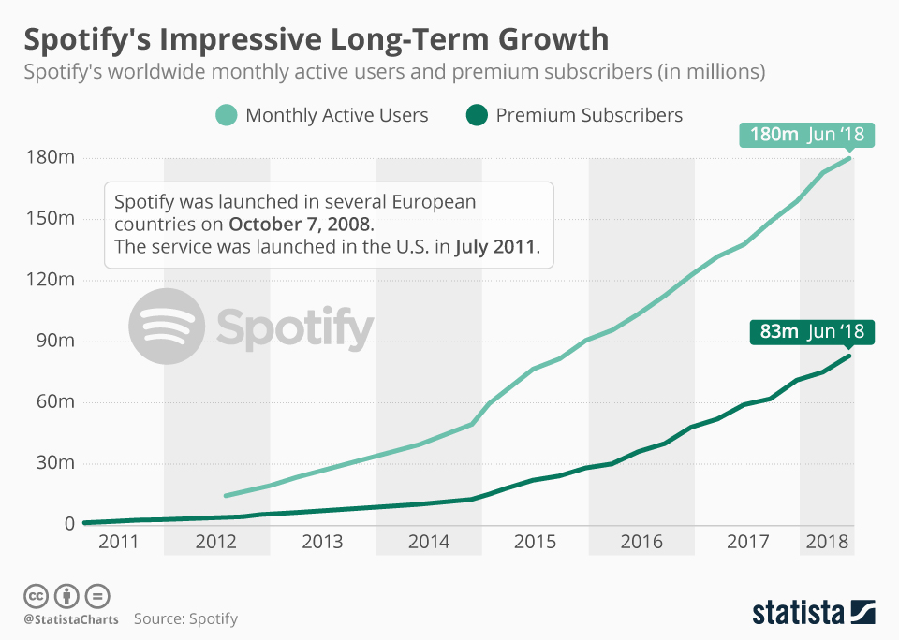
Companies today have a large marketing budget, unfortunately some are still trying to figure out how to get the best return on their investment. Data analysis can help us advise entertainment companies to achieve that goal. Spotify has been gathering data in the streaming music industry for the past 10 years across the world.
Our goal is to analyze streaming data from different parts of the world, to advise artist, organizations or entertainment companies; in a way that they can make informed decisions in their next campaign or investment.
With data visualization techniques we can simplify interpretation from 190 million subscribers, to better understand what customers are listening around the globe and perhaps understand their sentiment associates with those lyrics.
Source: https://www.statista.com/chart/15697/spotify-user-growth/

Slide 4
Advertisement
Pricing
Rank the streaming of songs and define their popularity
Spotify can increase price of advertisement when people click on top streaming songs
Musicians Branding
Analyze popularity of songs and singers across different countries
Musicians can improve their branding strategy and event schedule in different regions to increase their popularity
Concert Production
Rank the popularity of singers and link this to their concerts schedule and locations.
Music Production
Rank the popularity of songs and analyze the lyrics of them
Music producers can produce better music base on this analysis to catch market demand

Slide 5


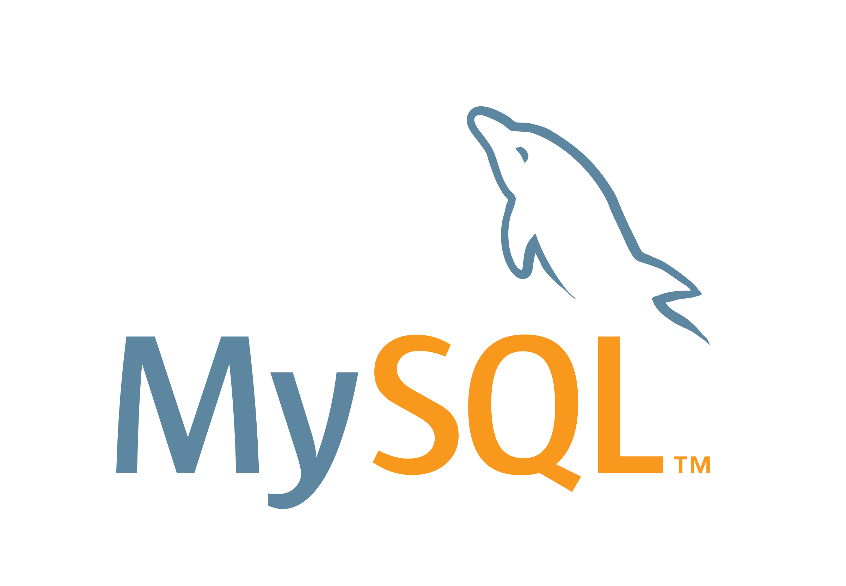





Web scrapping
Using R, Python scripts to extract data from website.
Storing the data and query data with MySQL Workbench and Tableau.
Tableau for data visualization.

Slide 6
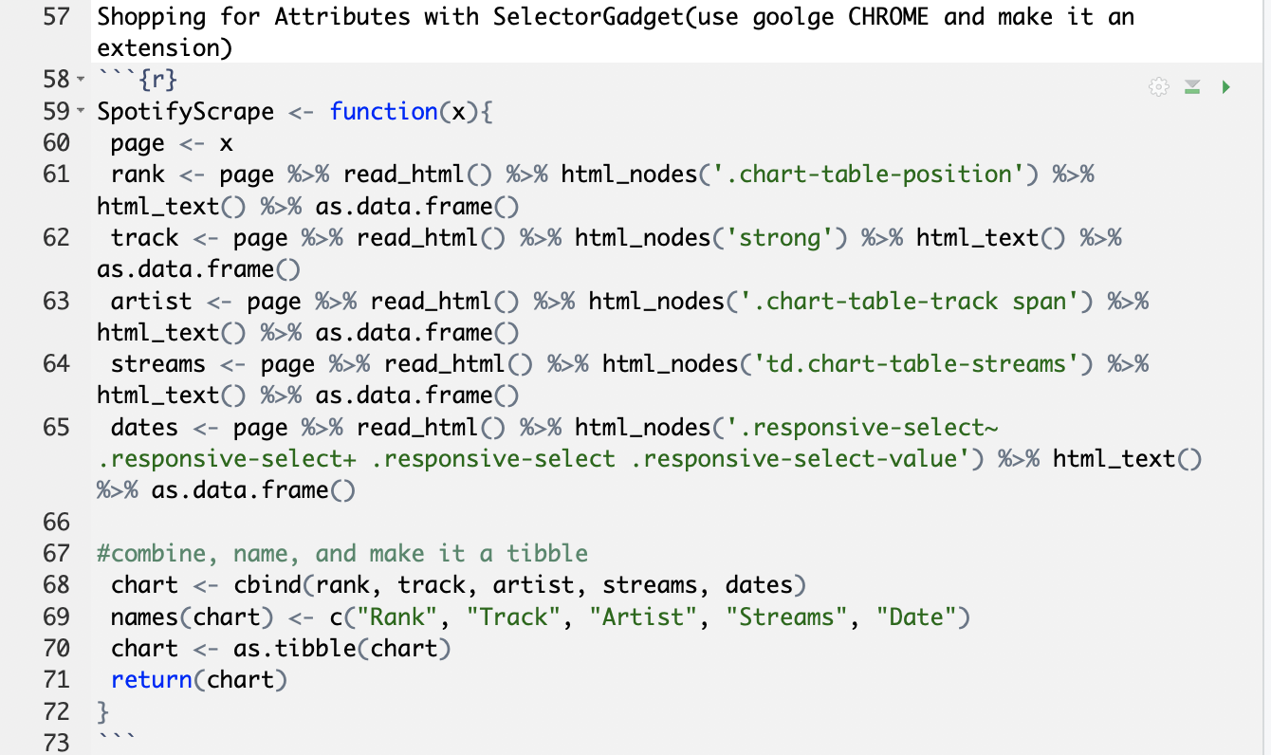
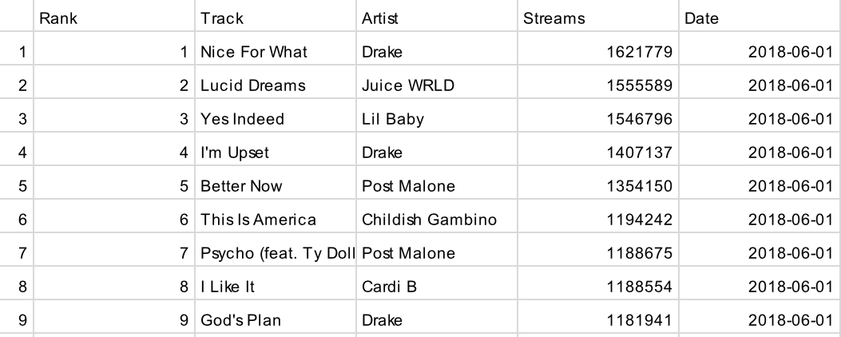
Code of Spotify table:
RStudio: the RVEST package and the Chrome Selector Gadget tool have allow us to collect HTML Nodes and download the data that we need to build our database. Out goal is to collect enough data to advise marketing campaigns before they decide to invest money in artist.
Outcome table

Slide 7
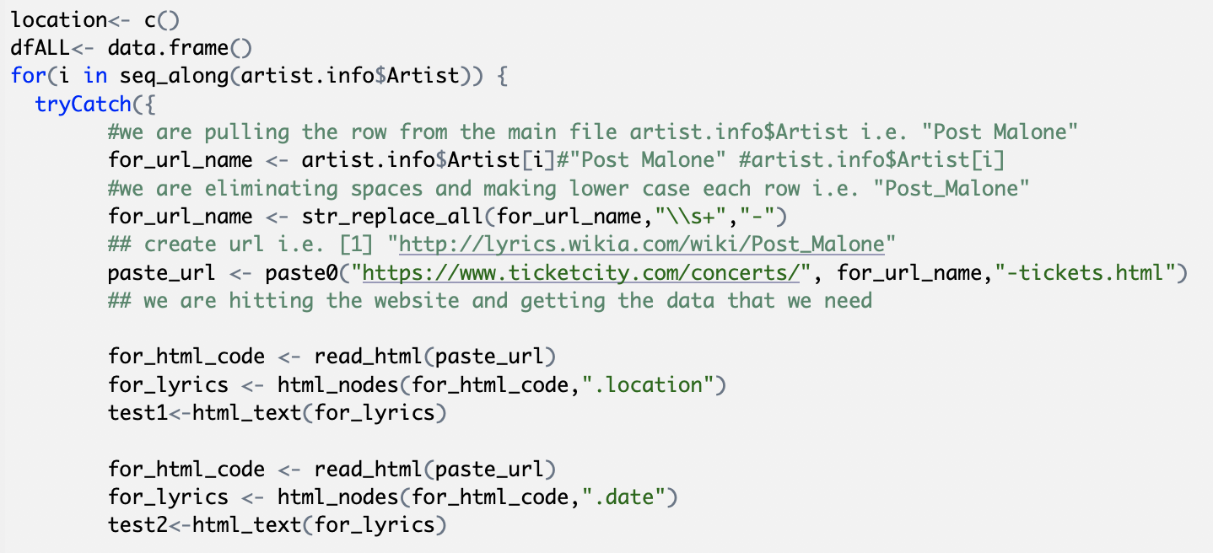
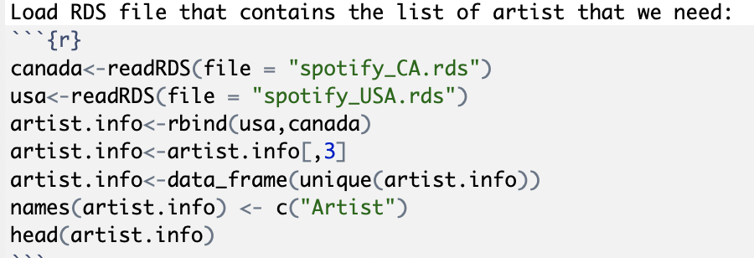
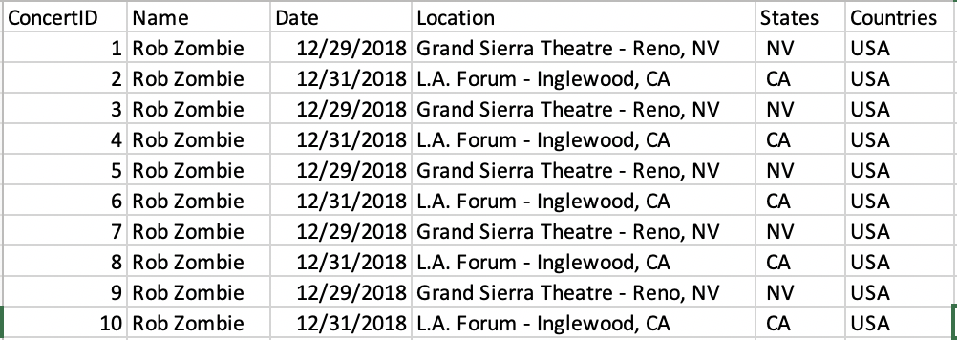
Code of Concert table:
Outcome table

Slide 8
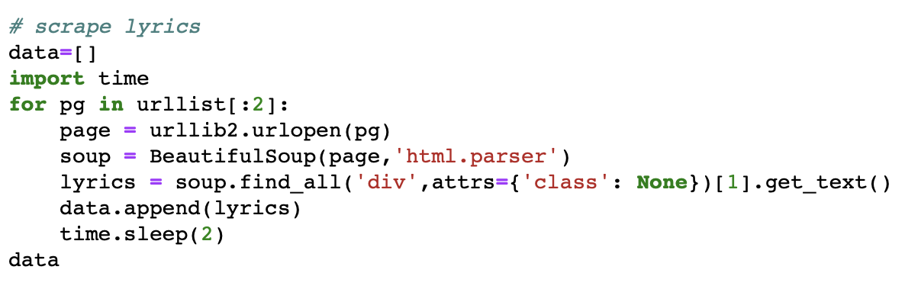
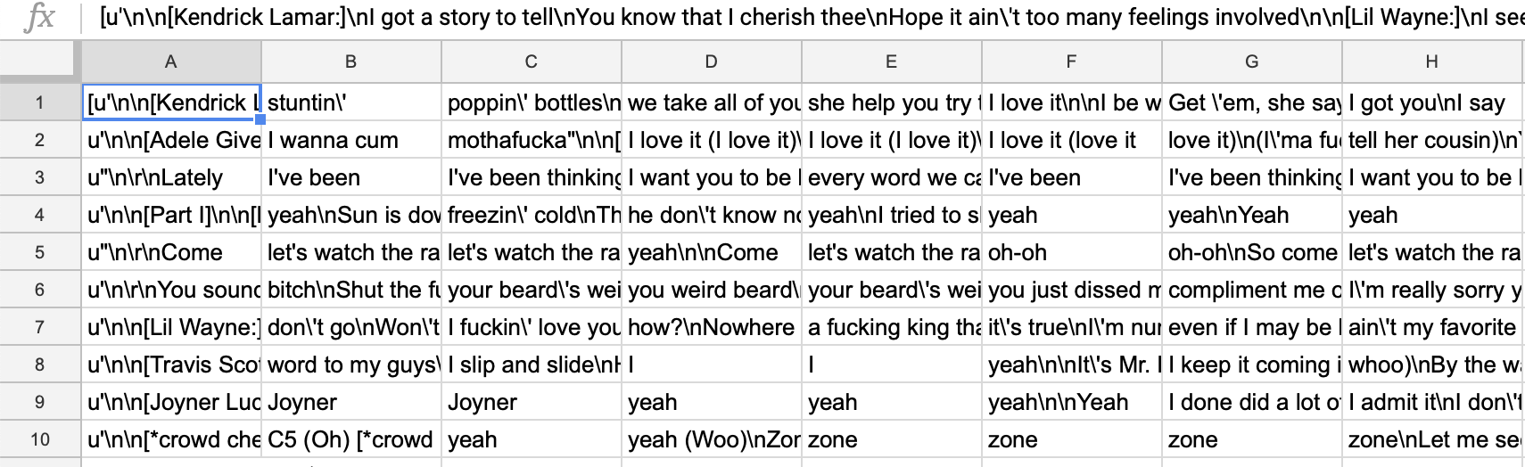
Code of Lyrics table:
Outcome table

Slide 9

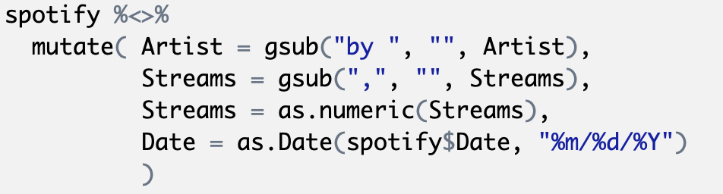
DATA CLEANING
Lubridate: date manipulation
Rvest: extract pieces out of HTML documents using XPath and css selectors.
html_nodes ()
Dplyr :Is a grammar of data manipulation, providing a consistent set of verbs that help you solve the most common data manipulation challenges:
mutate() select() filter() summarise() arrange()

Slide 10
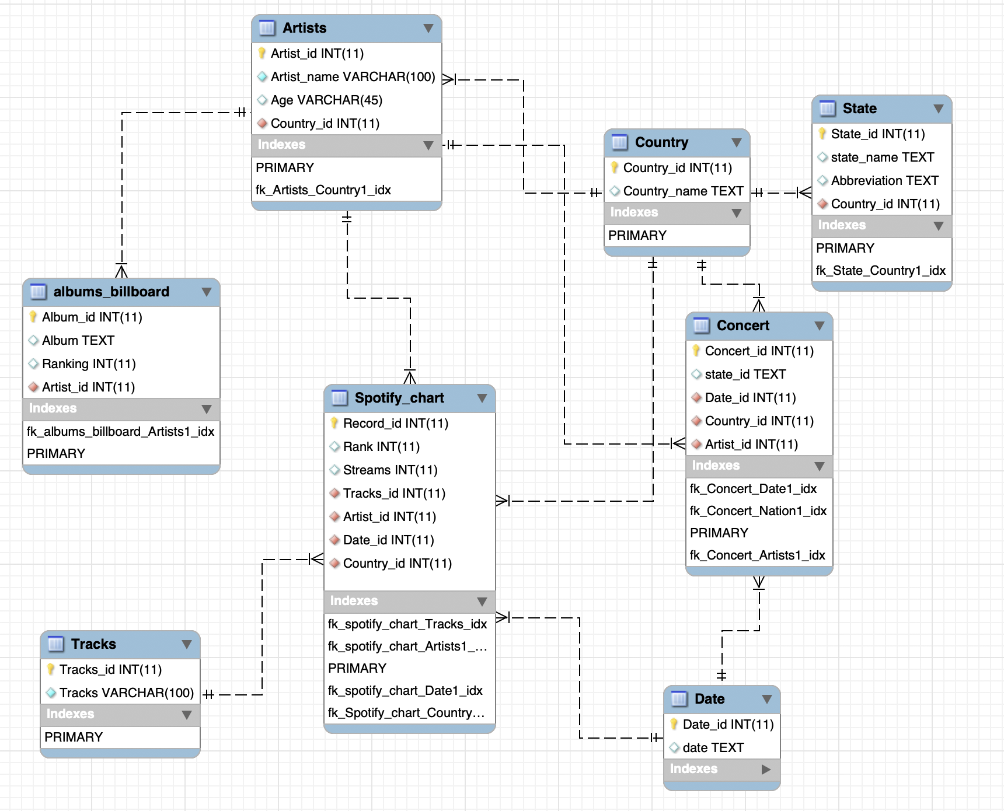
We have 5 main tables -- artist, albums, spotify, concert and songs
After normalization, we have extra tables – country, state and date, adding up to 8 tables
For attribute of ID, ranking, stream, age are INT type;
country_name, state_name, abbreviation, album and Artist_name are either TEXT or VARCHAR type
The nature of our database is snowflake database and our fact-table is Spotify_chart

Slide 11
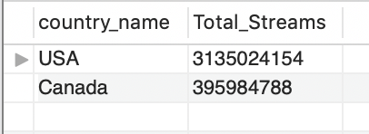
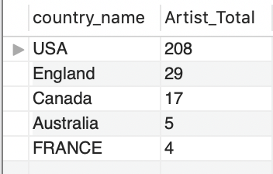
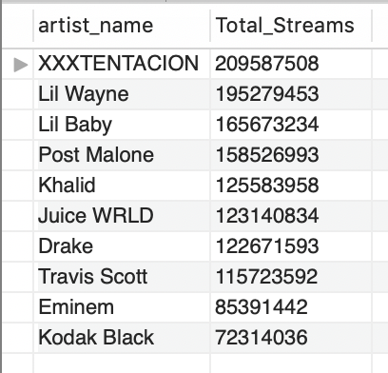
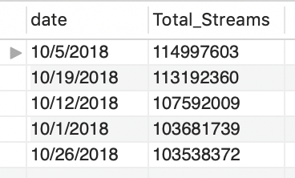
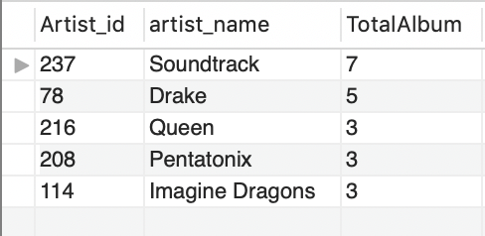
SQL QUERIES RESULT
Total of streams per Country
Top 5 countries with the most Artists
Top 10 artists with the most streams
Top 5 days with the most streams
Top 5 artist who in the top 200 billboard

Slide 12
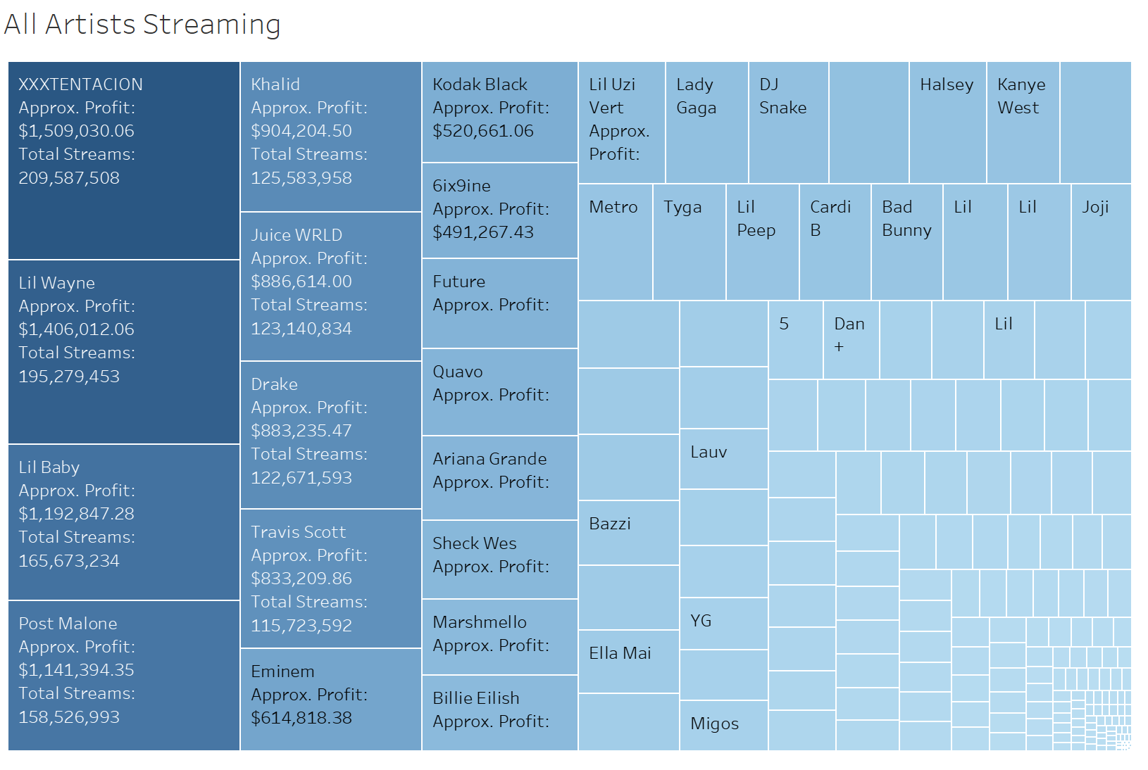
STREAMS
Quantify the relationship between streams and dollars
Dashboard to target potential artist for endorsements
Relationship between content with the highest streaming frequency and sentiment
Alignment between brand and artist values

Slide 13
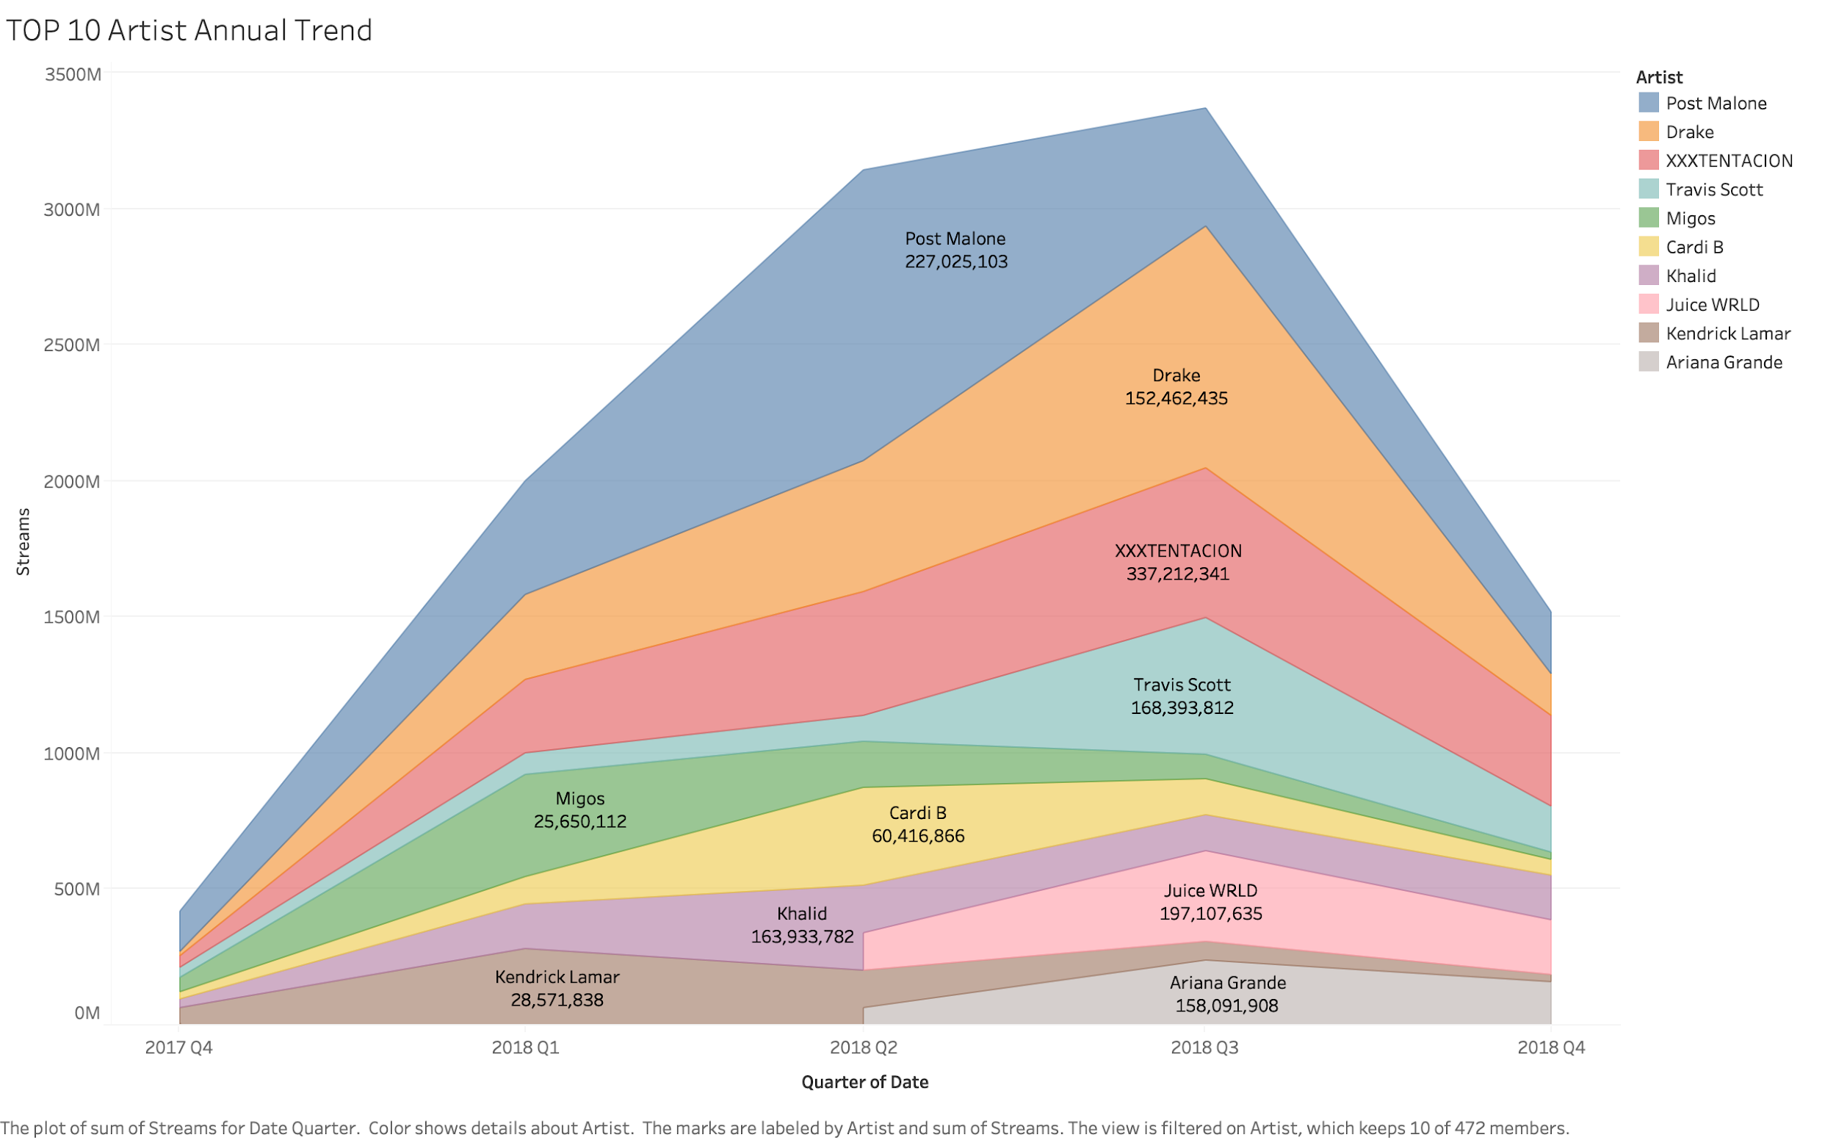
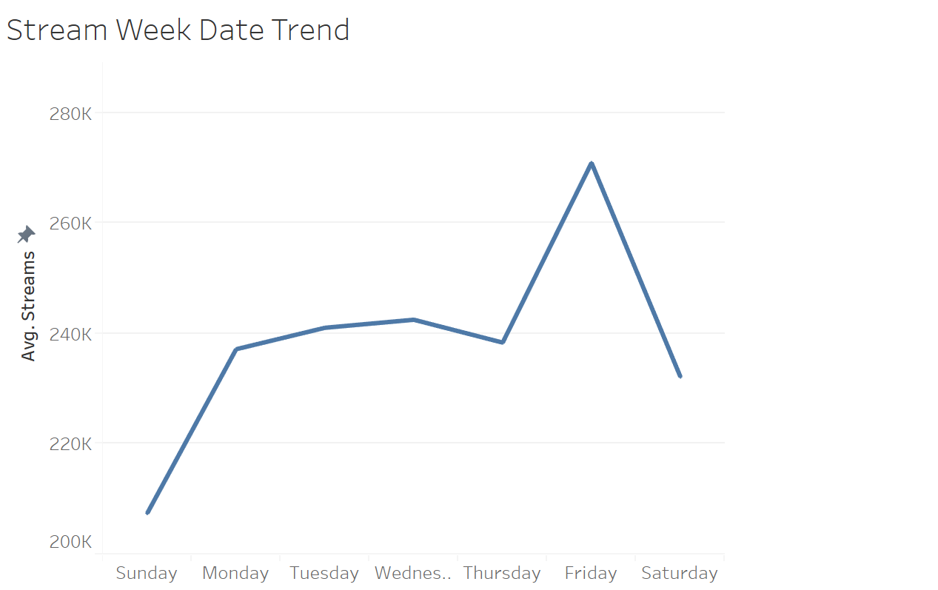
MUSICIANS TRENDS
Friday should be a good time to buy advertising on Spotify

Slide 14
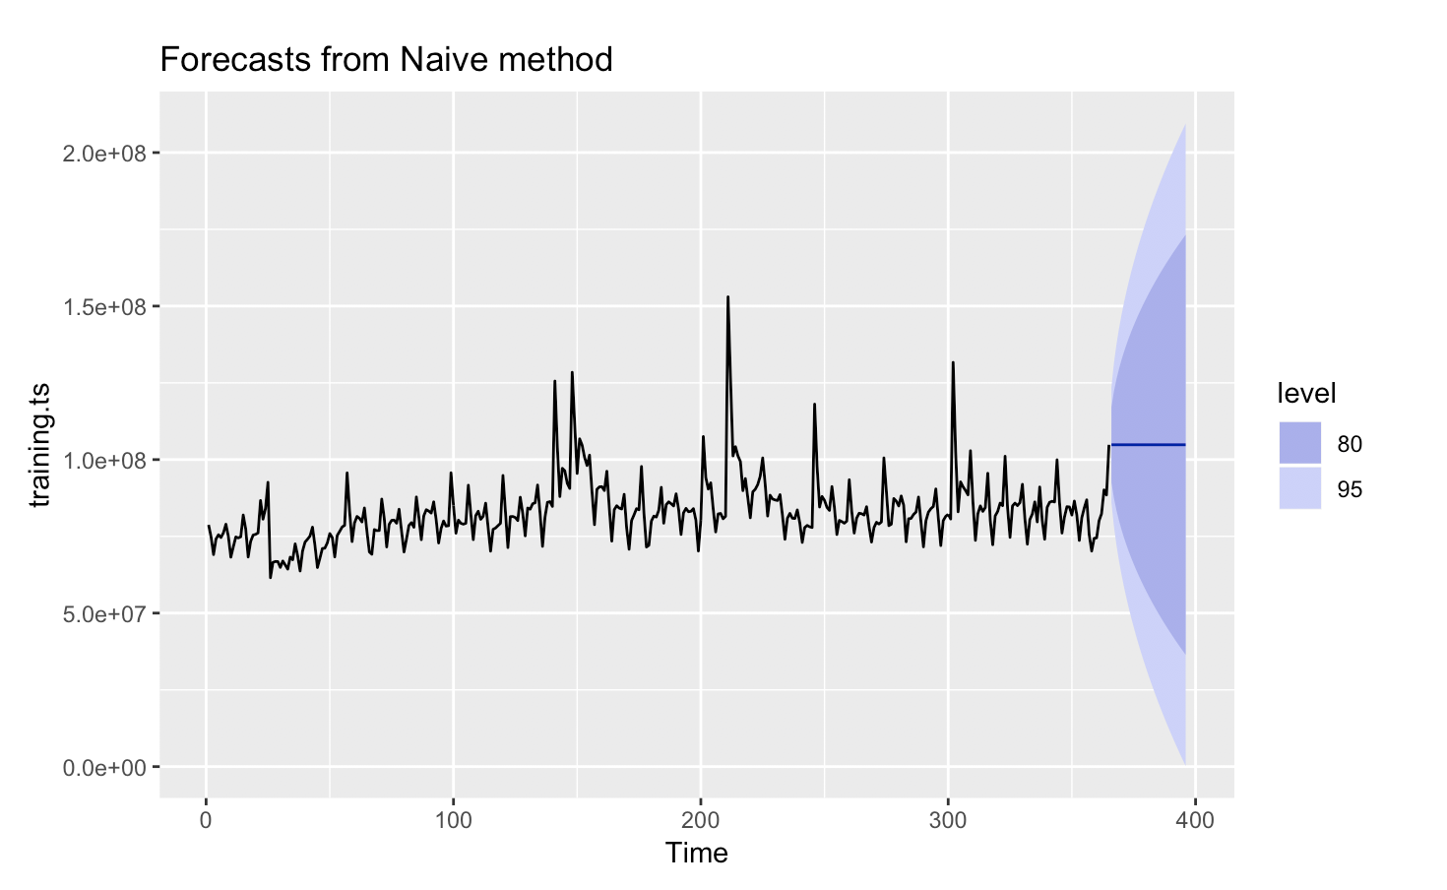
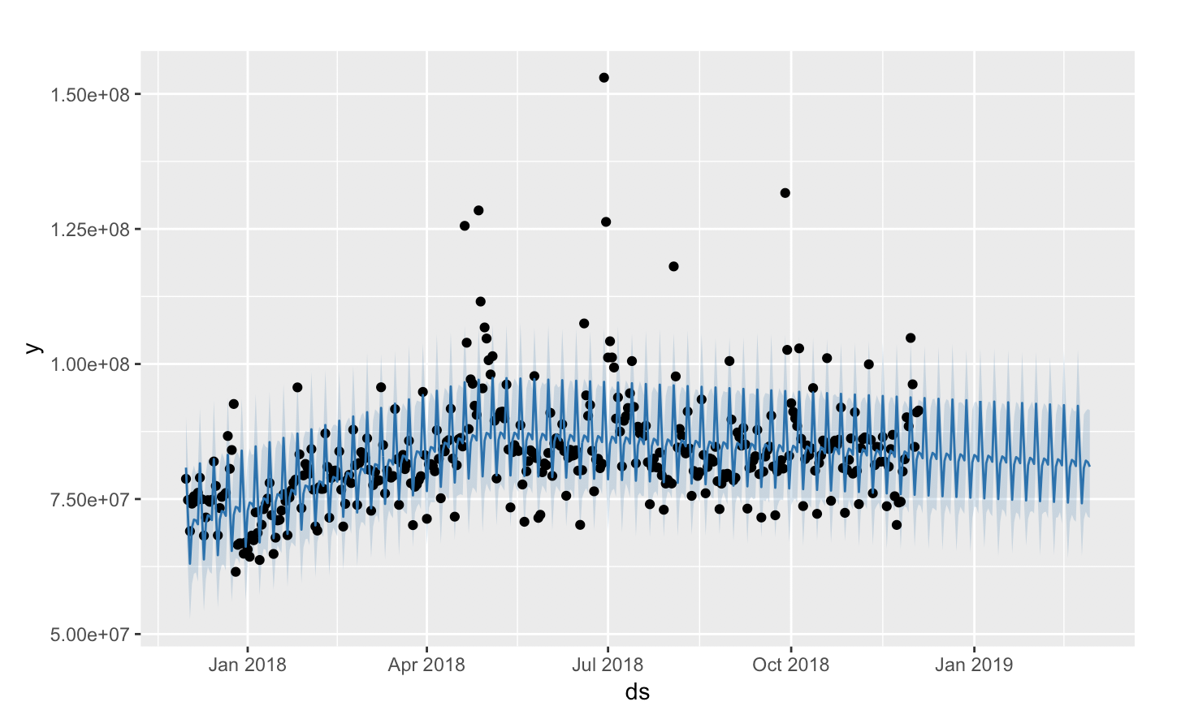
FORECASTING – NAIVE VS PROPHET

Slide 15
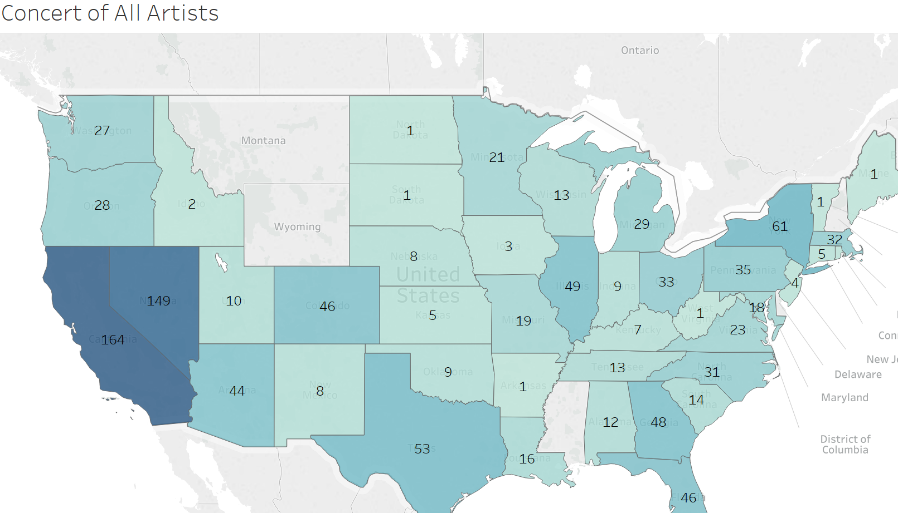
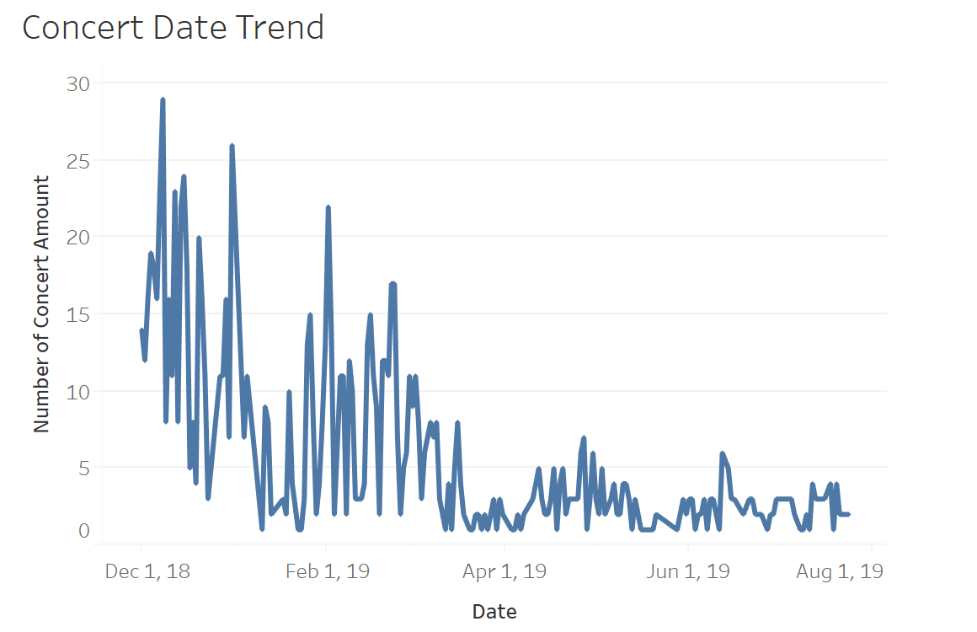
CONCERT PRODUCTION
States with more concerts can come with advertising campaigns to specific customers group like music fans
Most concerts are held on December and January.

Slide 16
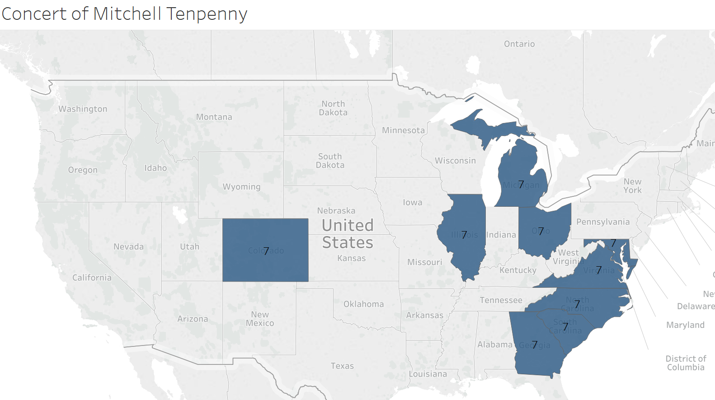
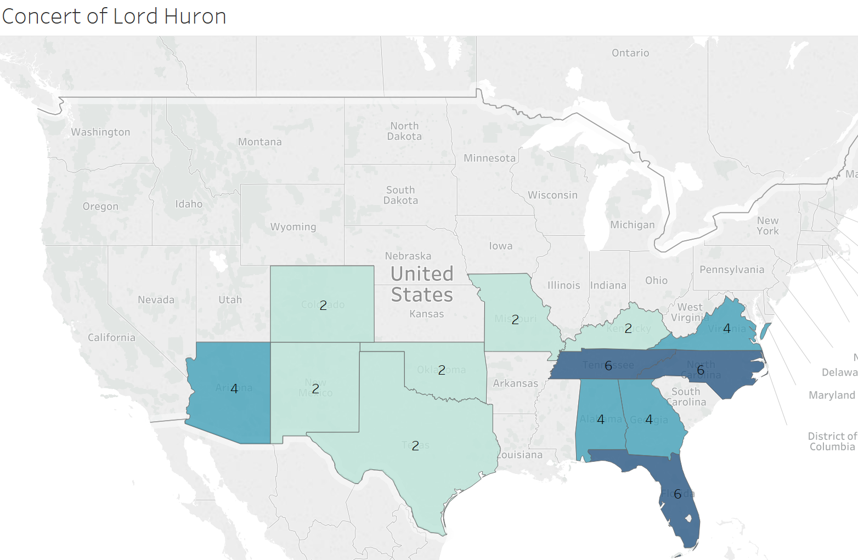
MUSICIANS BRANDING
Top artists have most concerts next year has different preference to hold their concert, they can exploit more locations based on top concert locations.

Slide 17
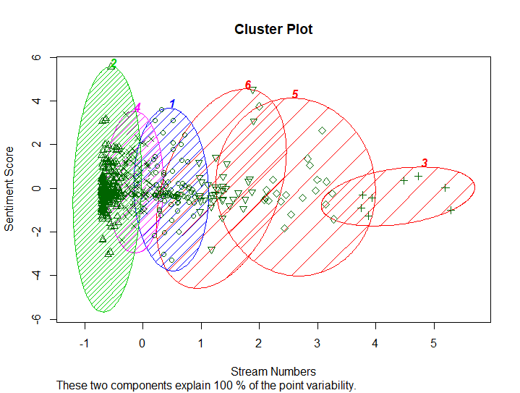
LYRICS ANALYSIS:
Sentiment Analysis: negative words “” positive words “”
Popular songs tend to be slightly negative
(correlation: -0.12), mean value is also negative
Most songs are centered around neutral sentiments
Some songs are very positive while being still very popular
Companies can identify artists that are overall positive or negative - drill down which artists resonate with their overall theme.
Companies can narrow down to songs that evoke specific emotion that can resonates with message of advertisement.
Notes:
Transition: As the final part of our analysis, we wanted to ask, how lyrics ____
First point: Popularity and sentiments are slightly negatively correlated. The mean sentiment value was also negative. Popular songs tend to have negative sentiments
Second point: However, most songs tend to be centered around neutral sentiments, so popular songs are never extreme
Third point: Notice that some songs are positive while being popular. This means that an advertisement company that wants a positive ad can strive for these songs , and using the code like ours can quickly isolate songs with positive sentiments while being very popular
Fourth point: Companies can also use this data to find artists, see which artists tend to produce songs that are negative or positive, songs that evoke certain type of emotion

Slide 18
Summary
We want to use Spotify data to help artists, advertisement companies, entertainment, and talent agencies to make more informed decisions
We collect artist, lyrics, stream, and concert ticket data, and evaluate metrics of popularity and sentiment
Entertainment and talent agencies can get an estimate of concert ticket price based on region
Advertisement companies can quickly narrow down songs and artists that better reflect the theme of advertisement

Slide 19
MORE DATA FOR DEEPER INSIGHT
Go more international, collect data from countries other than North America
Research and map the sentiments of successful advertisement songs to new songs in Spotify
Forecasting each artist’s total streams per day as time series data
Scrape more historical data rather than two-months frame
With greater abundance of longitudinal data, we can forecast with greater accuracy per artist, so go granular.
Notes:
Transition: for future work, we can improve our analysis by gathering more data
First point: We can go international. This will broaden our perspectives and see what patterns other countries have
Second point: We can research successful advertisement songs, determine their senitments, and map them to new songs in Spotify. We can go further to identify characteristics like music if we can somehow capture them in data
Third point: We can go granular with our stream data by segmenting time series by artist. This way we can have forecast for each artist rather than aggregate of artists
So, if we have more data than we can have deeper insight

Slide 20
DATA ENGINEERING IS HARDER THAN IT LOOKS!
Use “sleep system” when scrapping to prevent your IP Address to be blocked
Use API’s available instead of HTML nodes in web page scraping
Forecast analysis requires at least 2 years of data in order to capture seasonality
Some tools are more convenient and useful in certain aspects of data processing
Only having a few variables is often not enough to produce a satisfying analysis even though data collection and processing is very painful
Notes:
Transition: So we have made many mistakes, and what have learned from our mistakes in this project?
First point: our IP addresses got blocked many times. So, I had to go to Starbucks, Panera, and even gym to scrape new songs, which is very inefficient. So we really need to figure out a better way to scrape data without getting IP blocked.
Second point: if API is available, then use that instead of using HTML nodes. Also, if you can search the same information from different website that has API, use that
Third point, forecast analysis requires longer data set rahter than a few months in order to capture seasonality
Four, some tools are more convenient and useful in doing the same thing. For example, I found excel to be more user friendly and easier than R or Python reg expression
Fifth, this is a truism but we came to appreciate how hard it is to do data engineering, in statistics we analyze data that are processed and clean, but the actual analysis takes a lot less time than collecting data

Slide 21
THANK YOU

Slide 22
APPENDIX
https://www.statista.com/chart/15697/spotify-user-growth/
https://www.cnbc.com/2018/01/26/how-spotify-apple-music-can-pay-musicians-more-commentary.html
https://www.wikipedia.org
https://www.spotify.com/us/
https://www.spotify.com/ca-en/
https://www.billboard.com/charts/billboard-200
https://www.ticketcity.com
http://www.azlyrics.com
https://facebook.github.io/prophet/docs/quick_start.html#r-api

